Slide 1
Using Interlibrary Loan (ILL)
Welland Public Library

Slide 2
How to make an ILL Request

Slide 3
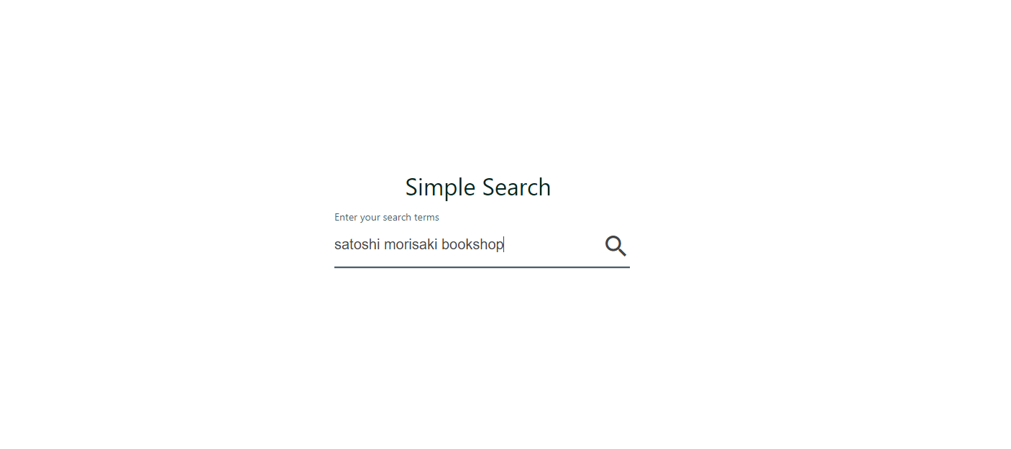
Do a search
Visit the ILL website at (you can insert your unique D2D URL here, or preferably,, the place on your website where you will place the link.
Search for the item using the title, author’s name, or a combination of both

Slide 4
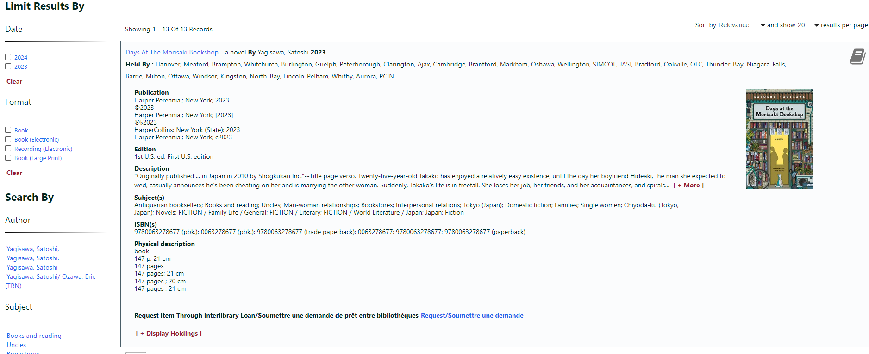
Search results
Click on an item to display the catalogue details. You can also narrow your search results by specific year, format, author, or subject, by using the left side bar
Submit your request using the link at the end of the description

Slide 5
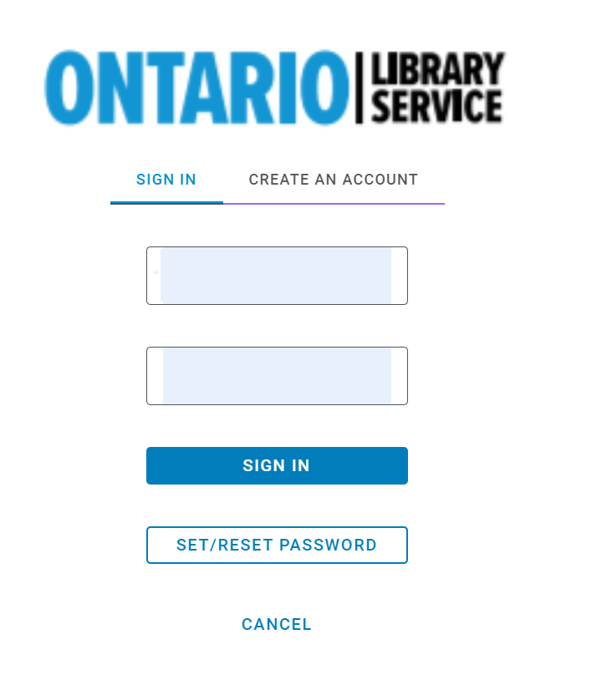
Sign in
You will be prompted to sign in. If you don’t have an account, you can click on “Create An Account”. If you have an account but don’t remember the password, you can reset it here.

Slide 6
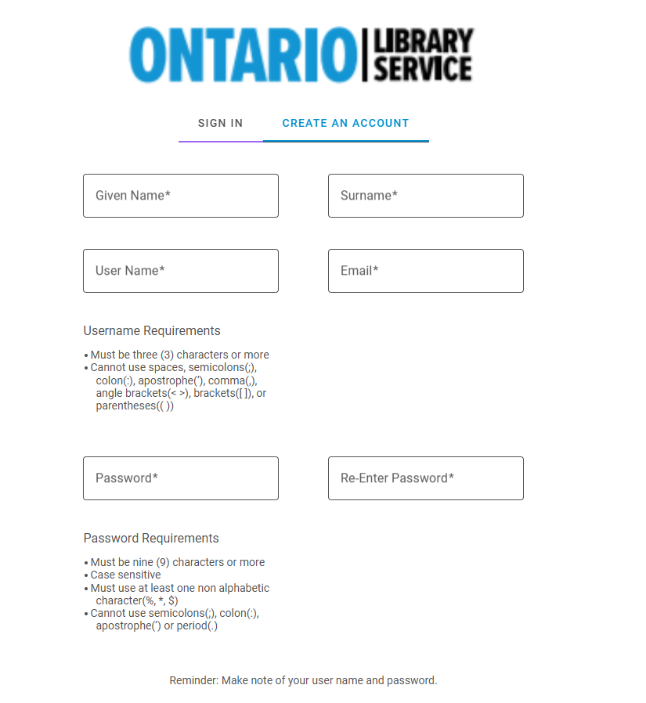
Create an account
If you are new to this system, fill out all the required fields to create a new account.
Make a note of your user name and password
Our library must approve all new accounts

Slide 7
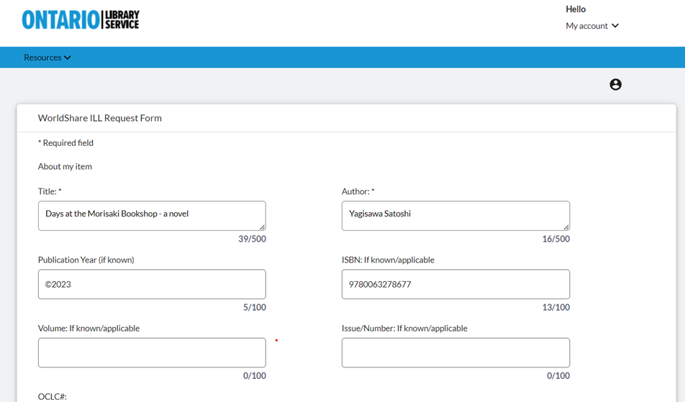
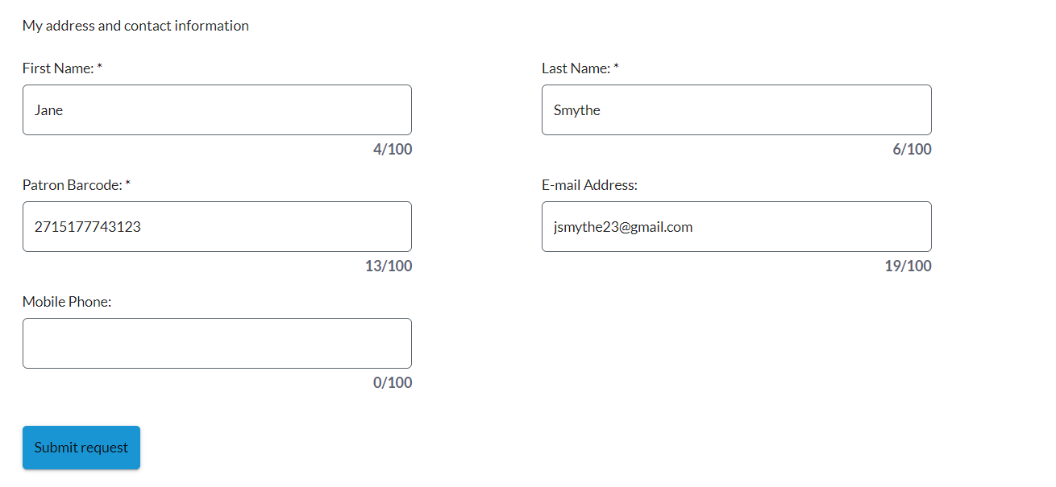
Request Form
After you sign in (or create an account for the first time), the details for your request and contact information will appear onscreen. Click the Submit button at the bottom of the screen to complete the request.

Slide 8
Request complete
You will receive confirmation on screen and by email, if you have provided an email

Slide 9
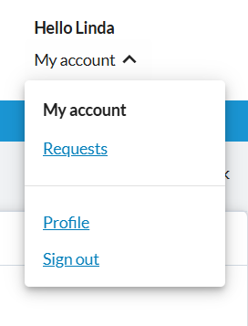
Sign out
When you are done searching for items and placing requests, you can sign out using the My Account menu on the top right on the screen

Slide 10
Using My Account

Slide 11
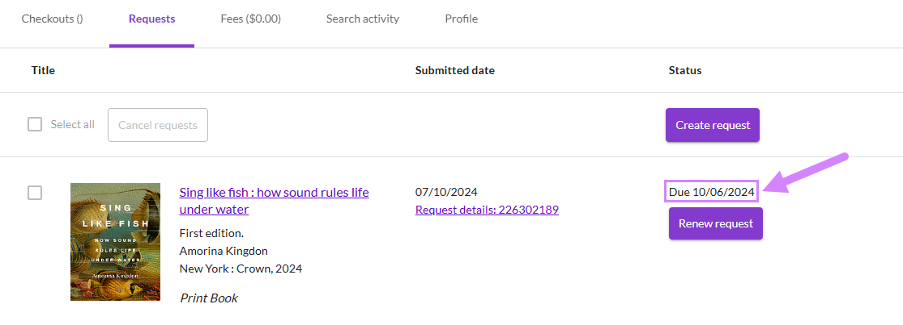
My Account
My Account allows you to track your current ILL requests

Slide 12
Patron Due Date
Your item’s due date displays next to the request in My Account

Slide 13
Cancel ILL requests

Slide 14
Cancel ILL Requests
If the library has not started processing the ILL request, the request will have a Selection box and can be chosen for cancellation
One canceled, the request will still appear in My Account, but will indicate it has been cancelled

Slide 15
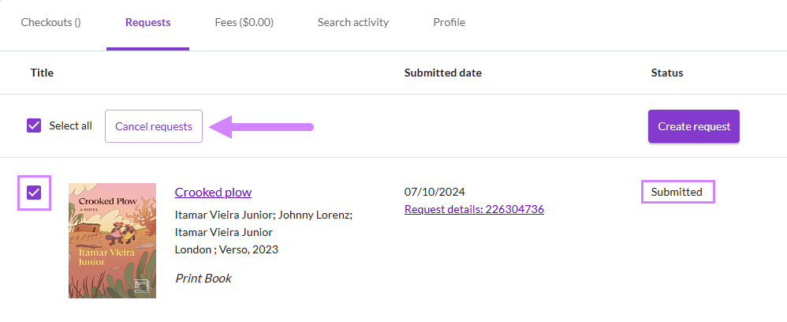
Cancel ILL requests

Slide 16
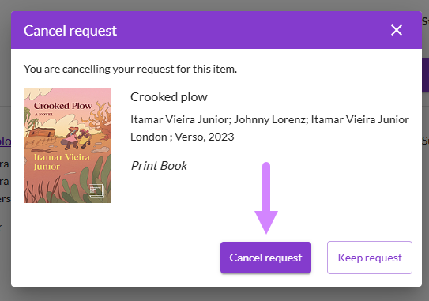
Cancel ILL requests

Slide 17
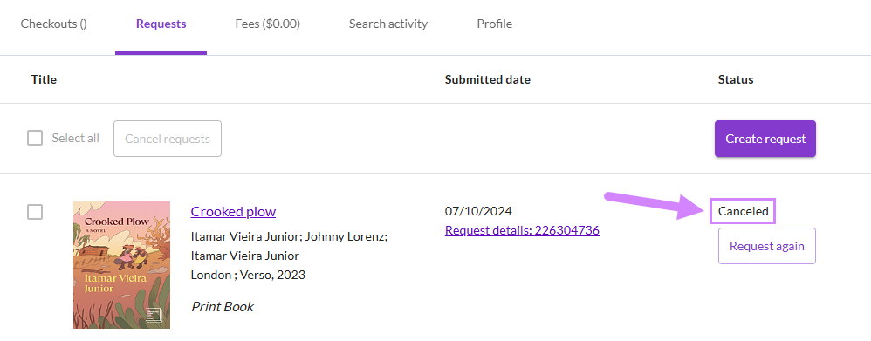
Cancel ILL requests

Slide 18
Thank you!
Welland Public Library

